Slide 1
Legislative & Policy Initiatives Working Group
Susan Shingledecker – Chair
Joyce Miller
Jeff Carothers
Matt Wellslager
Scott Perkins

Slide 2
Areas of Focus
HSRP cost reduction plan
Hydrographic Services Improvement Act –HSIA
Reauthorization
User Fees
Ten Most Wanted improvements

Slide 3
HSRP cost reduction plan
Background – NAV services budgets are shrinking, how can HSRP cut cost to aid in preserving program dollars?
Geographic location of meetings
Meeting logistics
Panel member compensation (stipend/salaries)

Slide 4
HSIA reauthorization
Unlikely to go forward in the 112th Congress
NOAA staff engaged in discussion with Congressional staffers
Prepare for 113th Congressional session
Release update Most Wanted report in 2013
Develop stronger ties in report to support HSIA

Slide 5
HSIA reauthorization
key topical area
Recommended levels of appropriation
Evaluation of use of user fees
Language specifically highlighting hydrographic needs in the Arctic region*
Evaluation of possible funding mechanisms for the PORTS system*
*assigned to other working groups

Slide 6
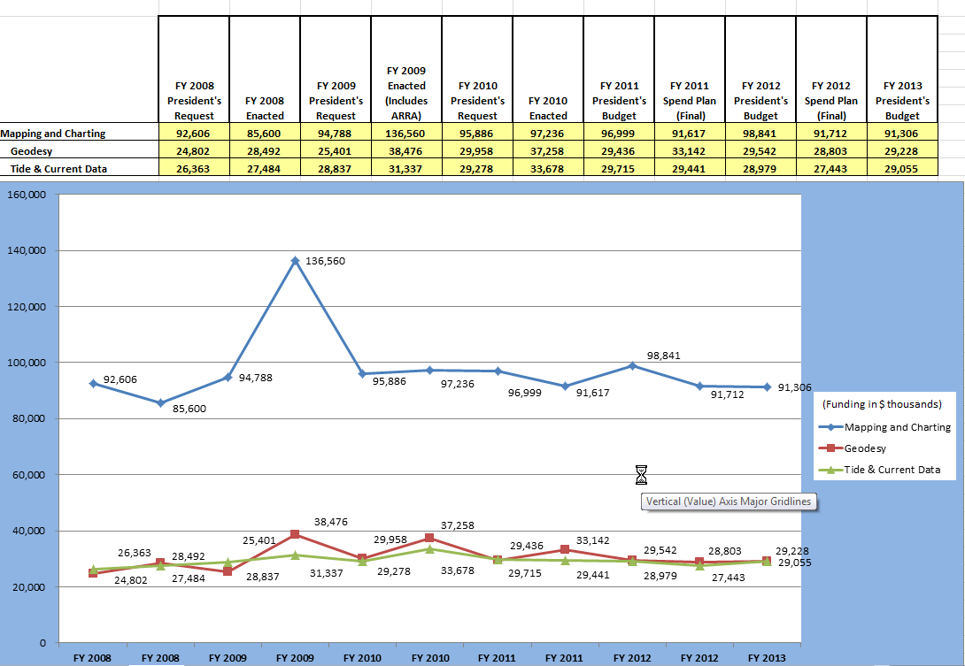
Levels of Appropriations

Slide 7
User Fees
Possible source for revenue
Successfully used by other NOAA offices (e.g. seafood inspection, NESDIS)
Current legislation (Section 1307 Title 44) prohibits user fees for “acquisition or processing of nautical data”
Current HSIA prohibits new fees
Possible candidates – PORTS, navigation response, other?

Slide 8
The Ten Most Wanted Report
Develop a one-page executive summary on HSIA for inclusion in the report
Make the connection with the need for HSIA reauthorization.
Focus on the potential for job creation and economic benefit

